Slide 1
CDS
Core Data Services
Overview and Tutorial

Slide 2
What you will learn
ABAP CDS Views Introduction
How to use the new Core Data Services (CDS) tools in ABAP in Eclipse.
How to use the following ABAP and SQL elements in a CDS view:
SELECT statement
CASE statement
WHERE clause
Notes:
In a nutshell, ABAP CDS Views is an important technology for modern application development on SAP systems and should not be overlooked. They provide enhancements in terms of data modelling and enable improved performance when combined with SAP HANA database.
ABAP CDS Views allow developers to create semantically rich data models which the application services expose to UI clients. It is the central pillar of S/4HANA development and is used as the core technology in most of SAP’s programming models.
Whether it is ABAP Programming Model for SAP Fiori, ABAP RESTful Application Programming Model, SAP Cloud Application Programming Model or S/4HANA Embedded Analytics CDS Views is the main technology used for data querying and modelling.
Created using an enhanced version of openSQL syntax, ABAP CDS Views reside in the application server (data dictionary) but process the logic in the database.
While the data in SAP is still physically stored in transparent tables, CDS Views are an abstraction layer on top of the tables for data modelling purposes. They understand the relationship between database tables and hide the complexity from the ABAP programmer.

Slide 3
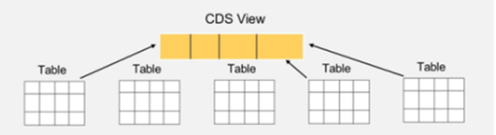
What Are ABAP CDS Views
Created using an enhanced version of openSQL syntax, ABAP CDS Views reside in the application server (data dictionary) but process the logic in the database.
While the data in SAP is still physically stored in transparent tables, CDS Views are an abstraction layer on top of the tables for data modelling purposes. They understand the relationship between database tables and hide the complexity from the ABAP programmer.
Notes:
In a nutshell, ABAP CDS Views is an important technology for modern application development on SAP systems and should not be overlooked. They provide enhancements in terms of data modelling and enable improved performance when combined with SAP HANA database.
ABAP CDS Views allow developers to create semantically rich data models which the application services expose to UI clients. It is the central pillar of S/4HANA development and is used as the core technology in most of SAP’s programming models.
Whether it is ABAP Programming Model for SAP Fiori, ABAP RESTful Application Programming Model, SAP Cloud Application Programming Model or S/4HANA Embedded Analytics CDS Views is the main technology used for data querying and modelling.
Created using an enhanced version of openSQL syntax, ABAP CDS Views reside in the application server (data dictionary) but process the logic in the database.
While the data in SAP is still physically stored in transparent tables, CDS Views are an abstraction layer on top of the tables for data modelling purposes. They understand the relationship between database tables and hide the complexity from the ABAP programmer.

Slide 4
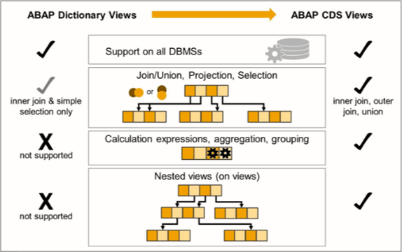
ABAP Dictionary Views vs. ABAP CDS Views
ABAP Dictionary views just link database tables, whereas CDS views bring many more features.
Such features include calculations, aggregations, more variations of table joins, and they can also be stacked with each other.

Slide 5
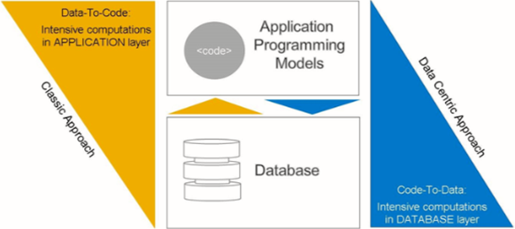
Why ABAP CDS Views?
The classic way when developers select the required data from a database and do further processing and manipulation on the application server.
all expensive calculations, aggregations and string operations should be done on the database level with only the resulting sets to be transferred to the application layer.
Notes:
The classic SAP development approach has been to keep the unnecessary load away from the database. Developers would select the required data from a database and do further processing and manipulation on the application server. The code would become complex (as its majority has been built for performance reasons) through the use of indexes and added no value to core business functions.
With the invention of SAP HANA database and consequent introduction of ABAP CDS Views this approach has changed. The new programming paradigm is called ‘code pushdown’ or “code to data”. The rule-of-thumb is to ‘do as much as possible in the database to get the best performance’.
And “as much as possible” means: all expensive calculations, aggregations and string operations should be done on the database level with only the resulting sets to be transferred to the application layer. SAP HANA database is optimised to complete such tasks. This leads to performance gains and reduction of the the complex application code. For comparison – huge amounts of data had to be transferred for processing with the classic approach. In some cases this could cause short dumps due to memory consumption limits.
SAP HANA is capable of aggregating on the fly. There is no need for pre-built aggregates and indexes since the data is organized using column stores. Also, in an S/4HANA system the data model has been simplified, by getting rid of tables necessary for aggregations and indexes.

Slide 6
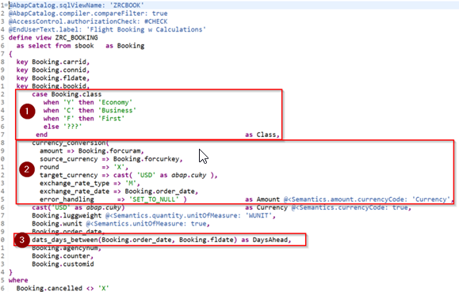
Code Pushdown – Example
Apart from regular fields selection from database table SBOOK this CDS view:
Uses a cases statement, based on the value of CLASS field it will return a corresponding value: ‘Economy’, ‘Business’, ‘First’.
Does a currency conversion from source currency to USD using a built-in function
Calculates the difference between order date and flight date using a built-in function
In the classic approach, all these calculations and conversions would have been done on the application server in ABAP. With CDS Views it is possible to do so on the database level.

Slide 7
Development Environment
“It is not possible to create CDS views in SAP GUI.”
The recommended tool for this task is Eclipse IDE with the ABAP Development Tools (ADT) plugin. This is a platform for modern ABAP related development. It is not limited to CDS views and can be used for developing other objects such as ABAP programs, classes, function modules etc.

Slide 8
HANA Studio
Installing abap development tools

Slide 9
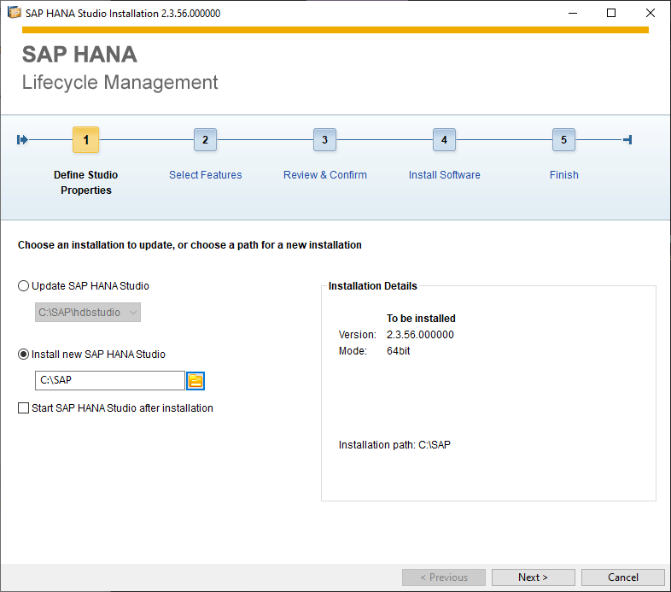
Installation - HANA Studio
Make sure installation path is outside system folder.
For example, C:\SAP is okay.

Slide 10
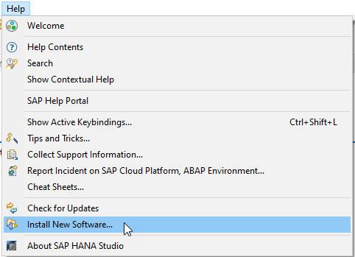
Installation - ABAP Development Tools
Click Help > Install New Software...

Slide 11
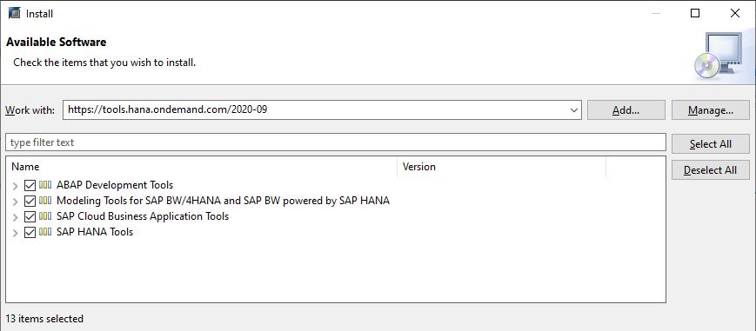
Installation - ABAP Development Tools
Work with: https://tools.hana.ondemand.com/2020-09

Slide 12
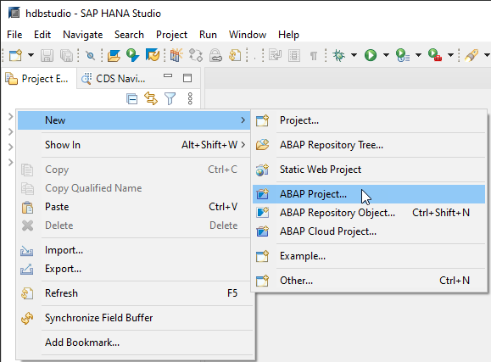
Add New Project
Right click on workbench panel then click New > ABAP Project…

Slide 13
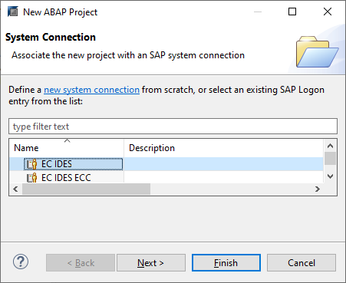
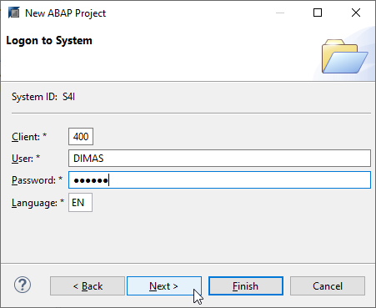
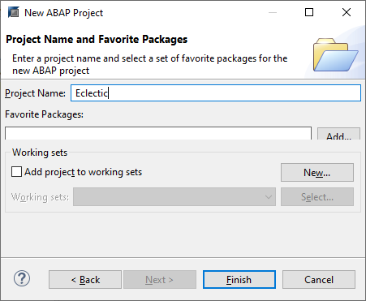
Add New Project
Choose system connection
Enter client, user, and password
Type in your Project Name

Slide 14
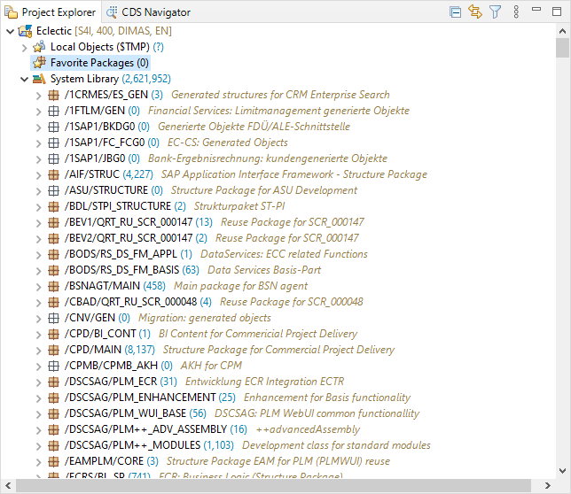
Assign Favorite Package
You need to assign your frequent package so you don’t need to scroll all the way down in system library every time you navigate the project.
Just right click on your desired package then click Add to Favorite Package

Slide 15
ABAP CDS
how to create a CDS (Core Data Services) view using ABAP Development Tools (ADT).

Slide 16
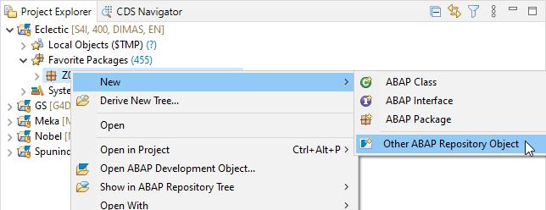
Step 1: Create a CDS view
1. In the context menu of your package choose New and then choose Other ABAP Repository Object.

Slide 17
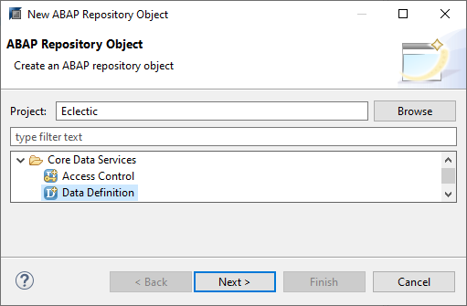
Step 1: Create a CDS view
2. Select Data Definition, then choose Next.

Slide 18
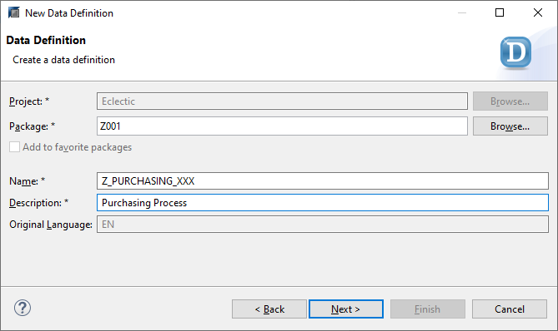
Step 1: Create a CDS view
3. Enter the following values, then choose Next:
Name = Z_PURCHASING_XXX
Description = Purchasing Process
4. Choose previous request or Create a new request then click Next.

Slide 19
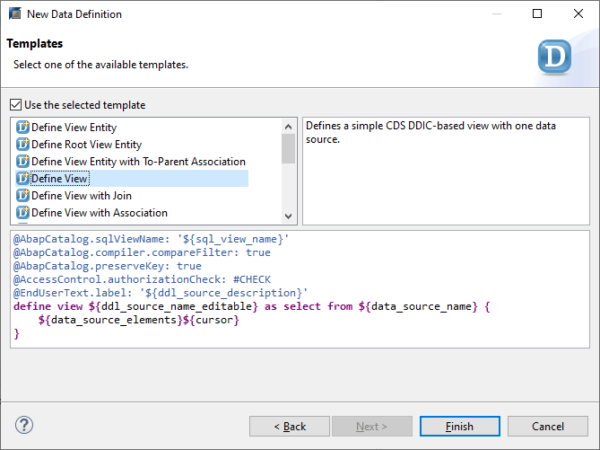
Step 1: Create a CDS view
5. Select the entry Define View, then choose Finish

Slide 20
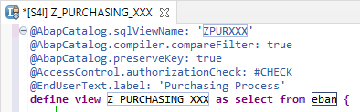
Step 2: Enter the data source
Enter ZPURXXX as the SQL view name.
Enter the CDS view EBAN as the data source for your view (in this case EBAN = Purchase Requisition Table).
The SQL view name is the internal/technical name of the view which will be created in the database. Z_PURCHASING_XXX is the name of the CDS view which provides enhanced view-building capabilities in ABAP. You should always use the CDS view name in your ABAP applications.

Slide 21
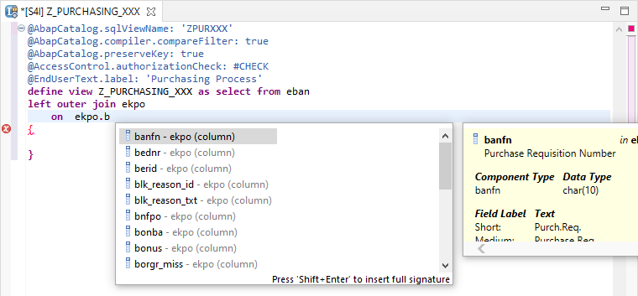
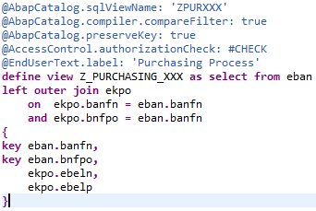
Step 3: Edit the SELECT statement
You will now join two tables EBAN and EKPO into the SELECT list as follows:
Trigger code completion in the SELECT list (by using keyboard shortcut CTRL+SPACE).
Enter join keys and list the fields you want to output

Slide 22
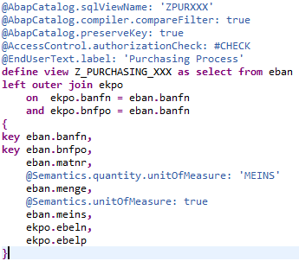
Step 4: Add Semantics Annotation
You can add currency or quantity reference by annotations directly

Slide 23
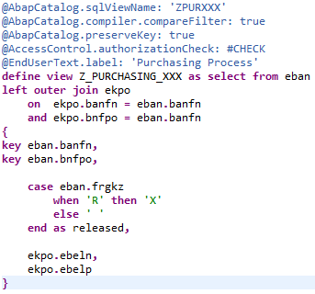
Step 5: Add a CASE statement
If the requisition has been released, then released field is true.
Remember to end with an alias because a statement in CDS needs a field name to contain the output

Slide 24
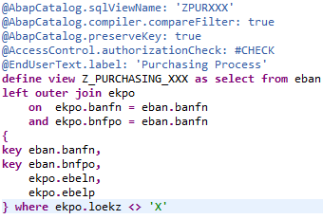
Step 6: Add a WHERE clause
You will now filter the results so that only purchase order that hasn’t been deleted.
Code where ekpo.loekz <> 'X' means to exclude items that has deletion indicator turned on.
Add a WHERE clause:
Save and activate the data definition by choosing Save ( Ctrl+S ) and Activate ( Ctrl+F3 ).

Slide 25
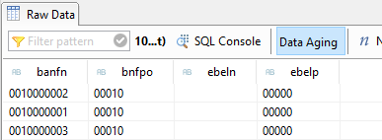
Step 7: Check your code and view your changes
Open the CDS View in the Data Preview by choosing F8. Your CDS View should look like this:

Slide 26
Fin

